Slide 1
REVIEW 2
SwitchVA
A Language-Switch-Aware Framework for Dimensional (Valence–Arousal)
Aspect-Based Sentiment Analysis in Hindi–English Code-Mixed Text
Model: NSSG-DimNet — Neuro-Symbolic Switch-Gated Dual-Graph Network
Team
Aditya Panda (23BAI1297) | Adhya Sharma (23BAI1280) | K. Mrinal (23BDS1022)
Guide
Dr. Madura Meenakshi

Slide 2
1. Domain Understanding & Problem Definition
The Problem
ASSUMPTION
Code-switch points are not random, they follow predictable syntactic structure (Sterner & Teufel, 2025) and carry usable signal about nearby aspect sentiment.
Sentiment analysis has shifted from 3-class polarity to dimensional (continuous) Valence - Arousal scoring formalised by SemEval-2026 Task 3 (DimABSA) across 11 languages.
None of DimABSA's 11 languages is code-mixed. Hindi - English “Hinglish” which is used daily by hundreds of millions across India, has no dimensional Aspect based sentiment analysis (ABSA) resource or model.
Prior Hinglish/multilingual ABSA work is limited to categorical sentiment, not continuous intensity.
Across all 11 DimABSA languages, arousal is consistently harder to predict than valence with no explanation offered for code-mixed settings.
CONSTRAINT
No existing dimensional ABSA annotated Hinglish corpus; token-level language identifiers must be sourced from L3Cube-HingCorpus and annotated for VA scores.
SIGNIFICANCE
First dimensional ABSA resource + model for Hindi-English code-mixed text; tests whether modelling switch points closes the arousal-prediction gap.
2

Slide 3
2. Literature Review & Gap Analysis
S No. | Author(s) & Year | Title / Focus | Method / Contribution | Research gap
1 | Pontiki et al., 2014 (SemEval-2014 Task 4) | Aspect Based Sentiment Analysis (foundational ABSA task) | Introduced aspect-term extraction and aspect-level categorical polarity classification (restaurant & laptop domains); established the ABSA task format later benchmarks build on. | Limited to discrete positive/negative/neutral polarity, cannot capture continuous emotional intensity, and covers only English restaurant/laptop domains.
2 | Pontiki et al., 2016 (SemEval-2016 Task 5) | Aspect Based Sentiment Analysis (extended, multilingual) | Extended ABSA to more domains and several languages; standardized aspect-category + polarity annotation schema across languages. | Standardizes categorical polarity across languages, but still no continuous valence-arousal dimension; no code-mixed language included.
3 | Mohammad, 2018 | Obtaining Reliable Human Ratings of Valence, Arousal & Dominance for 20,000 English Words (NRC-VAD Lexicon) | Built a large word-level lexicon of continuous Valence-Arousal-Dominance ratings using best-worst scaling; later extended with translations to 100+ languages including Hindi. | Provides only word-level (not aspect-level or sentence-level) VA scores; no mechanism to apply these priors to code-mixed or code-switched text specifically.
4 | Yu, Becker, Muhammad et al., 2026 (SemEval-2026 Task 3) | DimABSA: Dimensional Aspect-Based Sentiment Analysis | Introduced dimensional (valence-arousal) ABSA as regression instead of categorical polarity; 3 subtasks (regression, triplet, quadruplet extraction) across 11 languages; proposed the cF1 evaluation metric. | Defines dimensional ABSA across 11 languages, but none are code-mixed; arousal is reported as harder to predict than valence with no explanation given.
5 | Lee, Yu et al., 2026 | DimABSA: Building Multilingual and Multidomain Datasets for Dimensional ABSA | Describes construction methodology of the DimABSA multilingual/multidomain dataset used for the SemEval-2026 shared task. | Dataset-building methodology is designed for monolingual languages only, no guidance for annotating VA in code-mixed or code-switched text.
Thread
Representative Work
Gap Identified
3

Slide 4
S No. | Author(s) & Year | Title / Focus | Method / Contribution | Research gap
6 | Gazetas, Filandrianos et al., 2026 | AILS-NTUA at SemEval-2026 Task 3: Efficient Dimensional ABSA | Top-performing DimABSA system combining fine-tuned multilingual encoders for regression with LoRA-tuned LLMs for structured triplet/quadruplet extraction. | Achieves strong results only on DimABSA's monolingual languages; arousal prediction still lags valence, and the system was never tested on code-switching signals.
7 | Zhu, Zhao, Wang et al., 2024 (SIGHAN-2024 dimABSA Task) | ZZU-NLP at SIGHAN-2024 dimABSA Task: Coarse-to-Fine In-Context Learning | Earlier (pre-DimABSA/SemEval-2026) dimensional ABSA system for Chinese restaurant reviews predicting per-aspect Valence and Arousal via a two-stage in-context-learning method with an LLM. | Precursor to DimABSA restricted to a single monolingual language (Chinese); no extension to code-mixed settings or code-switch-aware features.
8 | Aguilar et al., 2020 | LinCE: A Centralized Benchmark for Linguistic Code-Switching Evaluation | Centralized, standardized benchmark aggregating multiple code-switched NLP tasks (incl. Hinglish sentiment) for fair comparison. | Aggregates code-switched NLP tasks including sentiment, but only at the categorical level — no dimensional (valence-arousal) task included.
9 | Khanuja et al., 2020 | GLUECoS: An Evaluation Benchmark for Code-Switched NLP | GLUE-style multi-task benchmark for code-switched Hindi-English and Spanish-English, including sentiment analysis. | Sentiment task in the benchmark is categorical classification only; no continuous intensity scoring for code-mixed text.
10 | Joshi et al., 2016 | Hinglish Sentiment Analysis Dataset | ~3,879 Hindi-English code-mixed Facebook posts annotated with 3-class sentiment; one of the earliest Hinglish sentiment resources. | Small-scale, 3-class sentiment labels only — no aspect-level annotation and no continuous valence-arousal scoring.

Slide 5
S No. | Author(s) & Year | Title / Focus | Method / Contribution | Research gap
11 | Raihan, Goswami et al., 2024 | Code-Mixed Sentiment and Hate-Speech Prediction | Studies joint sentiment and hate-speech prediction on code-mixed social media text, evaluating multilingual transformer models across code-mixed language pairs. | Focuses on categorical sentiment/hate-speech jointly; does not address aspect-level or dimensional (continuous intensity) sentiment.
12 | Nayak & Joshi, 2022 (L3Cube) | L3Cube-HingCorpus and HingBERT | Released the largest real Hindi-English code-mixed corpus (52.9M sentences, 1.04B tokens, scraped from Twitter) plus pretrained HingBERT/HingMBERT/HingRoBERTa language models. | Provides raw corpus and encoders for Hinglish, but no sentiment or VA annotations at all — a resource gap, not a task-level one
13 | Sheth, Nisar et al., 2025 | COMI-LINGUA: Expert-Annotated Large-Scale Dataset for Multitask NLP in Hindi-English Code-Mixing | 181,463-instance, expert-annotated Hinglish dataset covering language identification, matrix-language identification, POS tagging, NER, normalization, and translation. | Covers language ID, POS, NER, normalization, translation — but no aspect-based or dimensional sentiment annotation layer.
14 | Wu, Ma, Liu et al., 2025 | M-ABSA: A Multilingual Dataset for Aspect-Based Sentiment Analysis | Extends ABSA to multiple languages with parallel aspect-sentiment annotations across domains, following the SemEval ABSA schema. | Multilingual in scope but not code-mixed — each language is annotated monolingually; categorical polarity only, not continuous VA.
15 | Sterner & Teufel, 2025 | Code-Switching and Syntax: A Large-Scale Experiment | Large-scale computational analysis of the syntactic structure of code-switched text, testing linguistic-theory predictions (e.g. equivalence constraints) against real code-switching data at scale. | Shows switch points follow predictable syntactic structure, but never connects switch location to sentiment or emotional intensity.
Thread
Representative Work
Gap Identified
3

Slide 6
3. Objectives, Scope & Expected Outcomes
Objectives
Scope
1
Build the first dimensional (valence-arousal) ABSA dataset for Hindi-English code-mixed text, annotated over Hinglish reviews/social posts using token-level language labels.
In scope: Hindi-English code-mixed text only; aspect-level valence & arousal regression; single-domain pilot (reviews/social media).
Out of scope: other Indian language pairs, discrete emotion classification, real-time/production deployment.
2
Design NSSG-DimNet: a switch-gated, neuro-symbolic dual-graph model that explicitly encodes code-switch position as a feature for aspect-level VA regression.
3
Establish a multilingual-encoder baseline (e.g. HingRoBERTa / mDeBERTa) and test whether switch-awareness improves arousal prediction beyond it.
Expected Outcomes
A released Hindi-English DimABSA dataset filling a genuine resource gap.
NSSG-DimNet baseline results showing whether switch-awareness narrows the arousal-prediction gap seen across all 11 DimABSA languages.
A reusable switch-gated architecture applicable to other code-mixed language pairs.
4
Evaluate on standard DimABSA style metrics (e.g. Pearson r, MAE) for valence and arousal, per aspect.
4

Slide 7
4. Proposed Methodology
.
01
02
03
04
05
Data & Language Labelling
Encoding & Switch-Gating
Dual-Branch Processing
Fusion & Regression
Evaluation
Source Hinglish sentences (L3Cube-HingCorpus style); tag each token's language; compute Language Switch Distance per token.
Encode with a multilingual transformer (HingRoBERTa / mDeBERTa); add Switch Positional Embeddings; fuse via Switch-Point Gated Attention.
Branch 1: biaffine aspect-opinion span extraction. Branch 2: heterogeneous graph reasoning seeded with NRC-VAD affective priors.
Aspect-guided mutual cross-attention fuses both branches; two regression heads output continuous Valence and Arousal per aspect.
Compare against a switch-unaware multilingual-encoder baseline using Pearson correlation and MAE for valence and arousal.
5

Slide 8
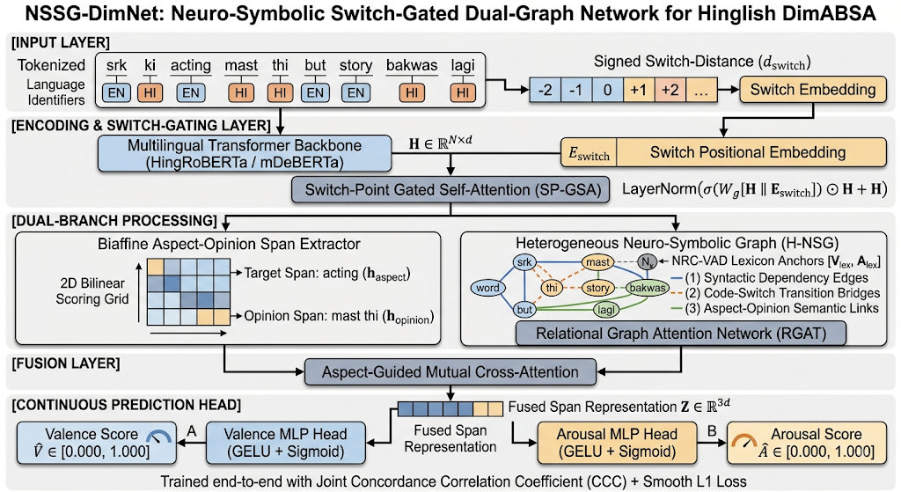
5. System Architecture — NSSG-DimNet
6

Slide 9
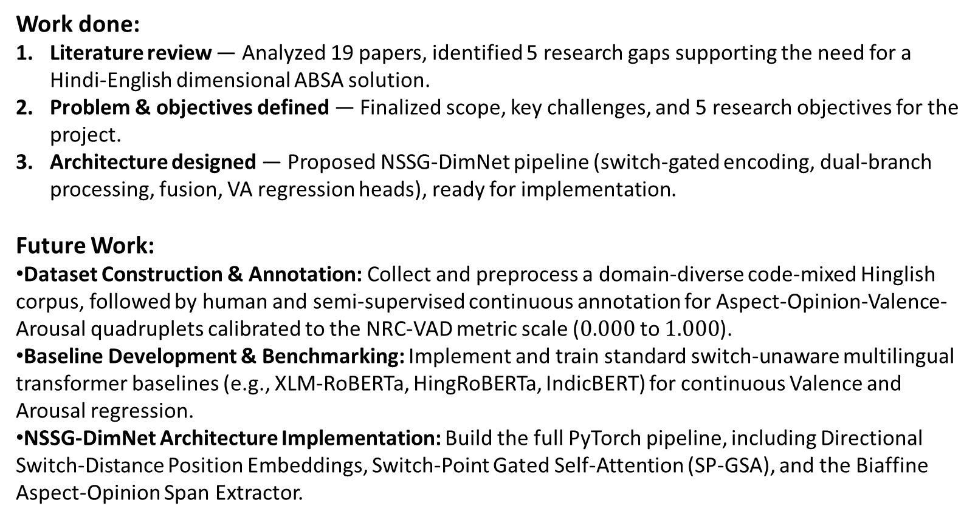
6. Work done and Future work
Work done:
Literature review — Analyzed 19 papers, identified 5 research gaps supporting the need for a Hindi-English dimensional ABSA solution.
Problem & objectives defined — Finalized scope, key challenges, and 5 research objectives for the project.
Architecture designed — Proposed NSSG-DimNet pipeline (switch-gated encoding, dual-branch processing, fusion, VA regression heads), ready for implementation.
Future Work:
Dataset Construction & Annotation: Collect and preprocess a domain-diverse code-mixed Hinglish corpus, followed by human and semi-supervised continuous annotation for Aspect-Opinion-Valence-Arousal quadruplets calibrated to the NRC-VAD metric scale ($0.000$ to $1.000$).
Baseline Development & Benchmarking: Implement and train standard switch-unaware multilingual transformer baselines (e.g., XLM-RoBERTa, HingRoBERTa, IndicBERT) for continuous Valence and Arousal regression.
NSSG-DimNet Architecture Implementation: Build the full PyTorch pipeline, including Directional Switch-Distance Position Embeddings, Switch-Point Gated Self-Attention (SP-GSA), and the Biaffine Aspect-Opinion Span Extractor.

Slide 10
7. References
[1] Pontiki, M. et al. (2014). SemEval-2014 Task 4: Aspect Based Sentiment Analysis. Proceedings of SemEval 2014, 27–35. https://doi.org/10.3115/v1/S14-2004
[2] Pontiki, M. et al. (2016). SemEval-2016 Task 5: Aspect Based Sentiment Analysis. Proceedings of SemEval 2016, 19–30. https://doi.org/10.18653/v1/S16-1002
[3] Mohammad, S. (2018). Obtaining Reliable Human Ratings of Valence, Arousal, and Dominance for 20,000 English Words. Proceedings of ACL 2018, 174–184. https://doi.org/10.18653/v1/P18-1017
[4] Yu, L.-C., Becker, J., Muhammad, S.H. et al. (2026). SemEval-2026 Task 3: Dimensional Aspect-Based Sentiment Analysis (DimABSA). https://arxiv.org/abs/2604.07066
[5] Lee, L.-H., Yu, L.-C. et al. (2026). DimABSA: Building Multilingual and Multidomain Datasets for Dimensional Aspect-Based Sentiment Analysis. https://arxiv.org/abs/2601.23022
[6] Gazetas, S., Filandrianos, G. et al. (2026). AILS-NTUA at SemEval-2026 Task 3: Efficient Dimensional Aspect-Based Sentiment Analysis. https://arxiv.org/abs/2603.04933
[7] Zhu, S., Zhao, H., Wang, X. et al. (2024). ZZU-NLP at SIGHAN-2024 dimABSA Task: Aspect-Based Sentiment Analysis with Coarse-to-Fine In-Context Learning. https://arxiv.org/abs/2407.15341
[8] Aguilar, G., Kar, S., Solorio, T. (2020). LinCE: A Centralized Benchmark for Linguistic Code-switching Evaluation. Proceedings of LREC 2020, 1803–1813. https://aclanthology.org/2020.lrec-1.223/
[9] Khanuja, S., Dandapat, S., Srinivasan, A., Sitaram, S., Choudhury, M. (2020). GLUECoS: An Evaluation Benchmark for Code-Switched NLP. Proceedings of ACL 2020, 3575–3585. https://doi.org/10.18653/v1/2020.acl-main.329
[10] Joshi, A., Prabhu, A., Shrivastava, M., Varma, V. (2016). Towards Sub-Word Level Compositions for Sentiment Analysis of Hindi-English Code Mixed Text. Proceedings of COLING 2016, 2482–2491. https://aclanthology.org/C16-1234/

Slide 11
[11] Raihan, N., Goswami, D. et al. (2024). Code-Mixed Sentiment and Hate-Speech Prediction. https://arxiv.org/abs/2405.12929
[12] Nayak, R., Joshi, R. (2022). L3Cube-HingCorpus and HingBERT: A Code Mixed Hindi-English Dataset and BERT Language Models. https://arxiv.org/abs/2204.08398
[13] Sheth, R., Nisar, S. et al. (2025). COMI-LINGUA: Expert Annotated Large-Scale Dataset for Multitask NLP in Hindi-English Code-Mixing. Findings of EMNLP 2025. https://arxiv.org/abs/2503.21670
[14] Wu, C., Ma, B., Liu, Y. et al. (2025). M-ABSA: A Multilingual Dataset for Aspect-Based Sentiment Analysis. Proceedings of EMNLP 2025. https://aclanthology.org/2025.emnlp-main.128/
[15] Sterner, I., Teufel, S. (2025). Code-Switching and Syntax: A Large-Scale Experiment. Findings of ACL 2025, 11526–11533. https://aclanthology.org/2025.findings-acl.600/

Slide 12
